Slide 1
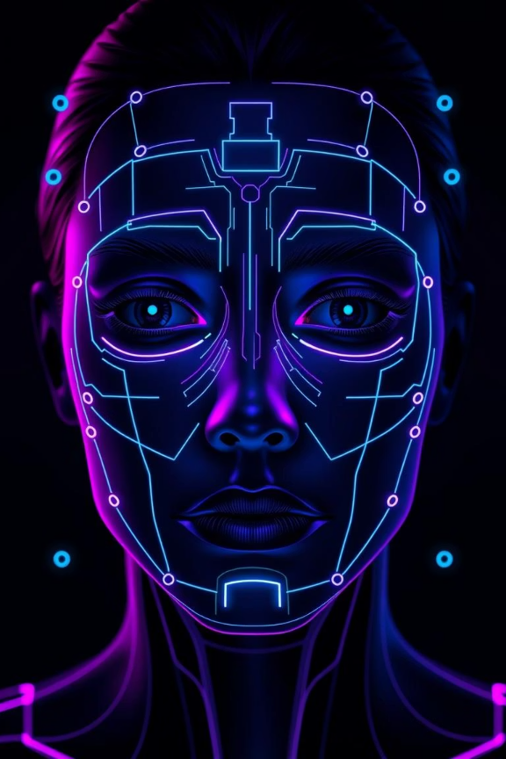


ISTVT: Interpretable Spatial-Temporal Video Transformer for Deepfake Detection
Presented by:
Anuj Gour
Aryan Gautam
(220181)
(220222)
Naman Patidar
Khushal Karadiya
(230679)
(230558)

Slide 2





Our Goal: Impactful Deepfake Detection
Presenting "ISTVT: Interpretable Spatial-Temporal Video Transformer for Deepfake Detection"
Clear Visuals & Transitions
Real-World Relevance
Minimalist Design
We use smooth, intuitive visuals and transitions to make complex concepts easy to understand and follow.
Our research directly addresses urgent challenges posed by deepfakes in media, politics, and society, connecting technical advances to real-world impact.
We focus on delivering key insights with clarity—prioritizing essential information over unnecessary text or clutter.

Slide 3
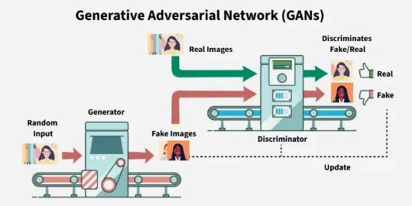
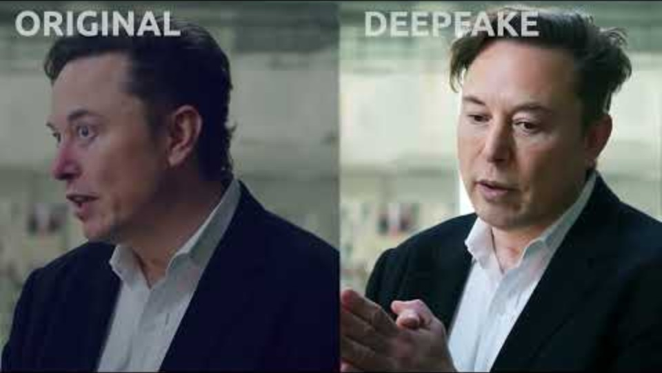
What Are Deepfakes?
Deepfakes are synthetic media—primarily videos—created using deep learning techniques, especially Generative Adversarial Networks (GANs), to replace or manipulate faces, voices, or actions in a realistic way.
🎥Usually face-swapped or manipulated videos and audio.
🤖 How?: Trained neural networks learn to generate highly realistic fake content.

Slide 4
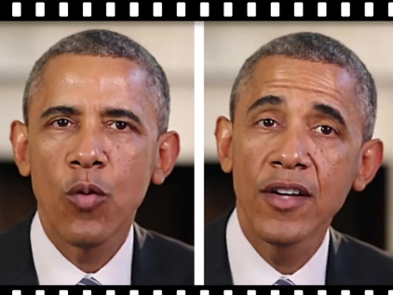
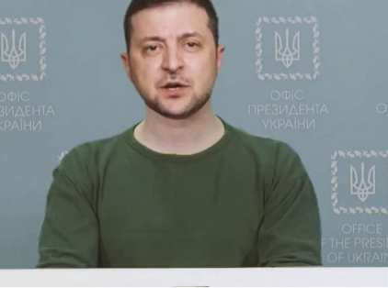
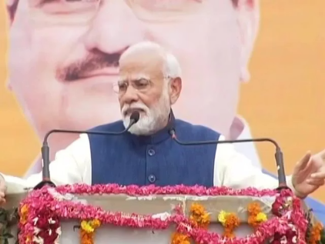

Deepfakes Are Fooling the World...
In 2018, a fake video of Barack Obama circulated giving a speech he never made.
The 2022 Zelenskyy deepfake aimed to spread disinformation during conflict.
Indian PM Modi deepfakes have appeared, highlighting political manipulation risks.

Slide 5
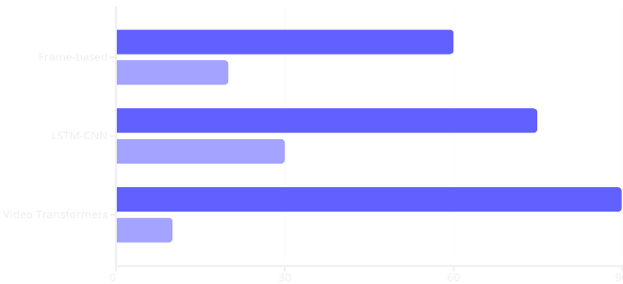


Where Current Models Fall Short
We need a model that sees both space & time... and explains why.
Frame-based
Poor on unseen fakes
Temporal Models
Can't isolate fine-grained artifacts
Transformers
Accuracy
Interpretability
Accurate but not interpretable

Slide 6

Introducing ISTVT 💡
Our new model, the Interpretable Spatial-Temporal Video Transformer (ISTVT), addresses the limitations of existing Deepfake detection methods.
Unlike frame-based CNNs, ISTVT captures temporal clues, enhancing detection on unseen fake videos.
Unlike Temporal models, ISTVT excels with fine spatial details, improving effectiveness on subtle, high-resolution forgeries.
Unlike traditional Transformers, ISTVT balances high accuracy with interpretability, allowing for detailed analysis.

Slide 7

Introducing ISTVT 💡
Spatial-Temporal Inconsistencies
Explainable Decisions
Heatmaps show reasoning
Captures both space and time
Superior Performance
Self-Subtract Mechanism
🚀 High Accuracy across datasets (FaceForensics++, DFDC, Celeb-DF)
Highlights subtle changes across frames by subtracting adjacent frame features → sharpens temporal clues.
🧩 Better Generalization on unseen deepfake techniques
🔍 Explainable AI – trustworthy and transparent decisions

Slide 8
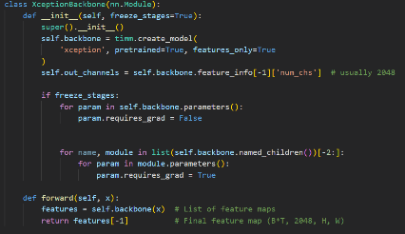
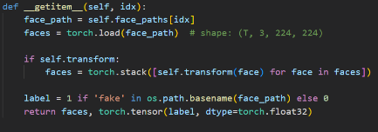
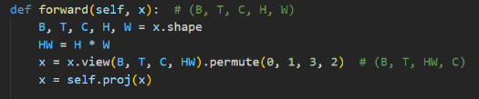
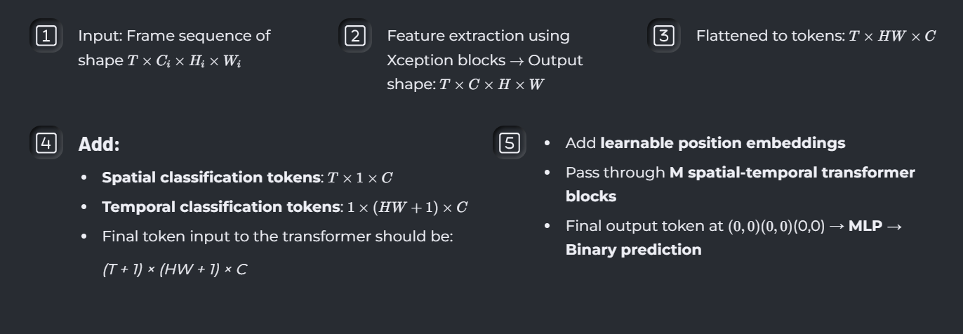





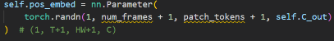
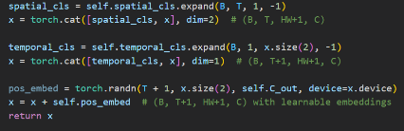
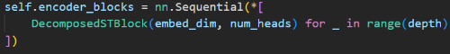

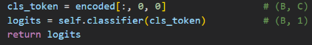
ISTVT Architecture
Input: Frame sequence of shape T \times C_i \times H_i \times W_i
Feature extraction using Xception blocks \to Output shape: T \times C \times H \times W
Flattened to tokens:
Add:
Add learnable position embeddings
Spatial classification tokens: T×1×C
Pass through M spatial-temporal transformer blocks
Temporal classification tokens: 1×(HW+1)×C
Final token input to the transformer should be:
Final output token at (0,0)(0, 0)(0,0) → MLP → Binary prediction
(T + 1) × (HW + 1) × C

Slide 9


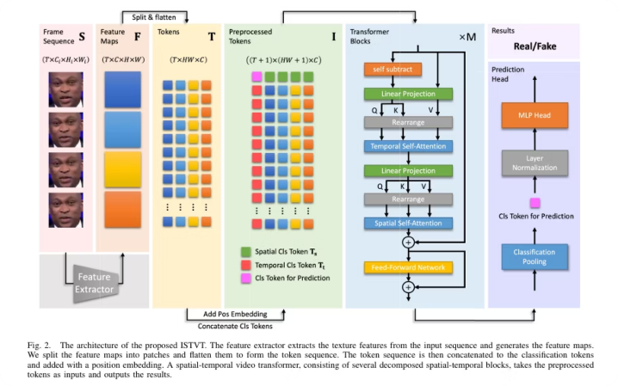



Architecture Overview
Xception
xtracts low-level spatial texture features from each frame (Entry flow of Xception used).
Patch Tokenization
Splits feature maps into spatial patches and flattens them into tokens
Spatial-Temporal Transformer
12 transformer blocks with decomposed Spatial & Temporal Self-Attention and a Self-Subtract mechanism.
MLP Classifier
Uses learned classification token for Real/Fake prediction via MLP head.

Slide 10
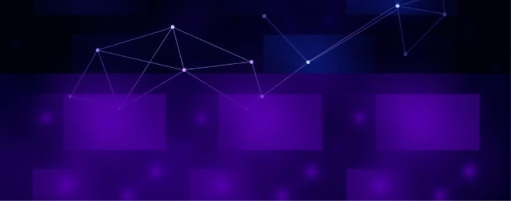

Separate Attention for Space and Time
Temporal Attention
Spatial Attention
Looks across same patch over time.
Looks at all patches in same frame
Operates over temporal dimension (time/frames)
Operates over spatial dimensions (height × width)
Captures motion dynamics and temporal consistency
Captures scene structure and spatial context
This separation significantly improves interpretability, allowing precise identification of manipulation.

Slide 11
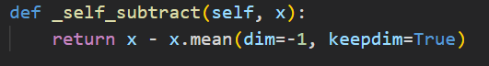
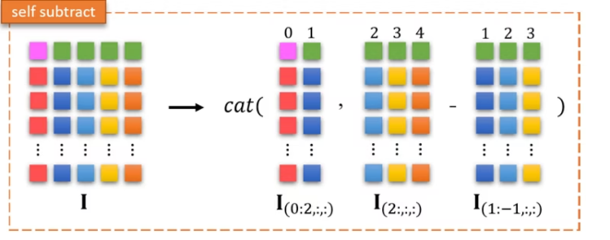
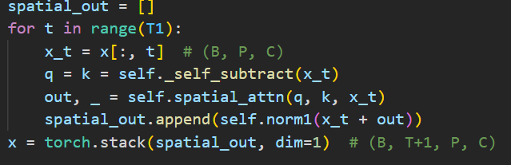
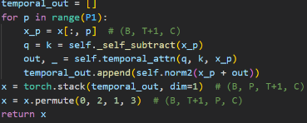
Self Subtract Mechanism:
1
Highlights Temporal ArtifactsSubtracts adjacent frame tokens to focus on inter-frame distortions.
2
Removes Redundancy, Retains DetailsSuppresses unchanging features while preserving important spatial cues using original tokens for value projection.
The Self-Subtract Mechanism computes the difference between adjacent frame tokens to highlight temporal inconsistencies and suppress redundant static features before applying temporal self-attention.
3
Boosts Detection RobustnessEnhances model focus on meaningful temporal changes → better generalization and performance.
.

Slide 12
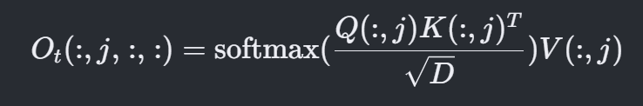
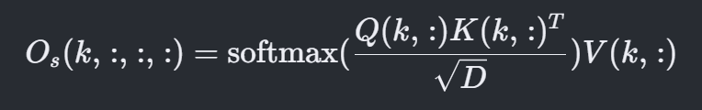
Mathematics of Decomposed Attention
Temporal Attention (at spatial index j):
Spatial Attention (at temporal index k):
Reduced Attention Complexity:

Slide 13

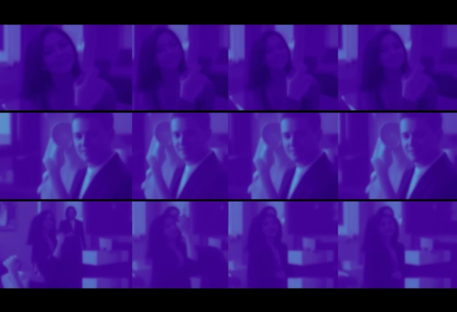
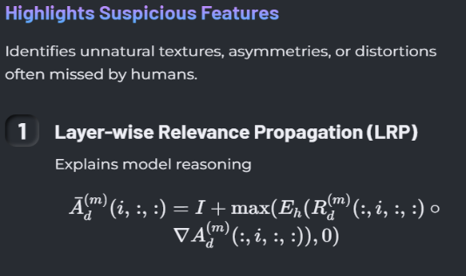
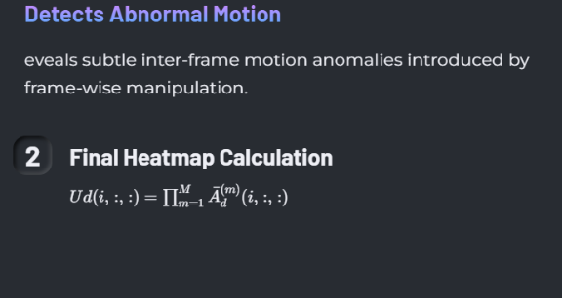
How ISTVT Explains Its Decisions

Slide 14
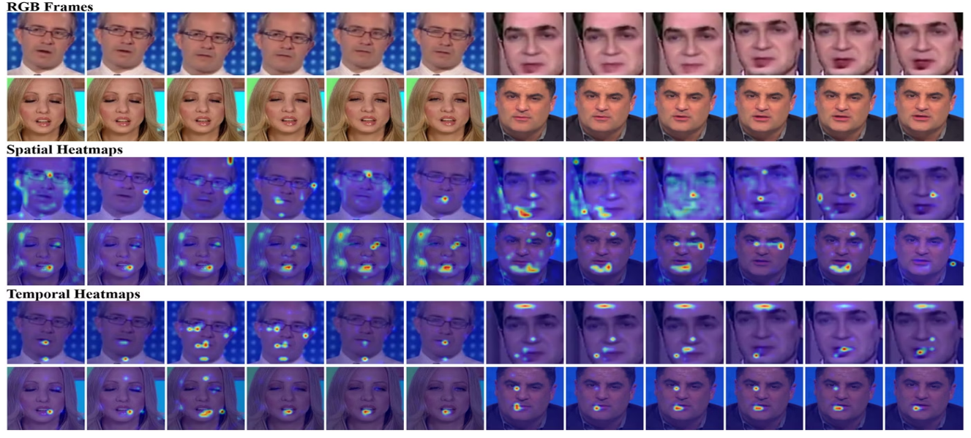

Visualisation of Spatial and Temporal Heatmaps
Spatial Heatmap: Highlights specific regions within a frame that show anomalies or manipulations, such as unnatural textures or facial distortions.
Temporal Heatmap: Visualizes inter-frame inconsistencies and sudden changes, pinpointing where motion anomalies or temporal artifacts occur.
Temporal Heatmap: Visualizes inter-frame inconsistencies and sudden changes, pinpointing where motion anomalies or temporal artifacts occur.

Slide 15
🧪 Experimental Setup
Datasets
Preprocessing & Training Details
Training Details Cont.
FaceForensics++: 1000 real + fake videos from 4 manipulation methods
Feature Extractor: Entry flow of Xception
Face detection: MTCNN
Alignment: Based on nose landmark
Transformer: 12 blocks, 8 heads
Celeb-DF: 590 real, 5639 high-quality fake videos
Optimizer: SGD with warm-up, LR = 0.0005
Resize: 300×300 facial crops
DFDC: Preview set from Deepfake Detection Challenge (2020)
Sequence: 6 continuous aligned frames
Hardware: 4× Tesla V100 GPUs, 100 epochs
270 frames used per video (FaceForensics++)
Selection: Best model via validation accuracy
FaceShifter, DeeperForensics: High-quality fakes built on FaceForensics++

Slide 16
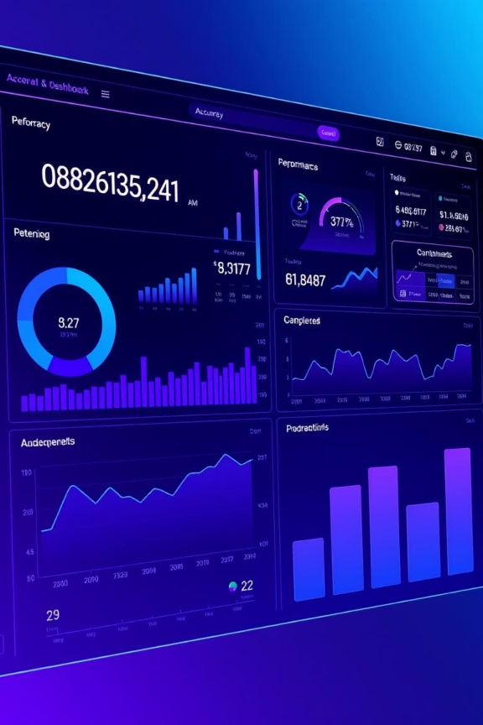
Performance
1) Intra-Dataset Performance (Same dataset for training and testing):
Datasets Used: FaceForensics++, Celeb-DF, DFDC.
ISTVT significantly outperforms other models like ViViT, VidTr, VTN, and CNN-based Xception (XN-avg).
CNN-based methods like VidTr often miss fine temporal clues.
ISTVT captures both spatial & temporal artifacts, boosting accuracy.

Slide 17
Performance
2) Cross-Dataset Performance (Trained on FF++, tested on others):
Evaluation Metric: AUROC.
ISTVT shows strong generalization, especially on difficult datasets like DFDC.
Compared to FTCN (which uses longer sequences), ISTVT performs better in:
Complex conditions (e.g., varying lighting/head pose).
Interpretability (clear separation of spatial/temporal focus).
Intra-dataset accuracy.

Slide 18
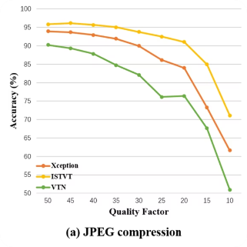
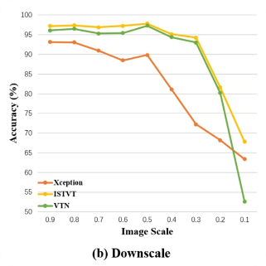
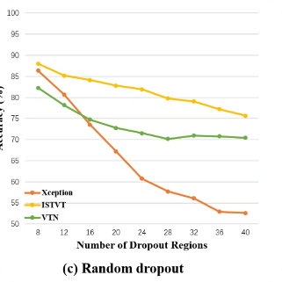
Robustness to Perturbations
Evaluating Model Performance on Noisy Deepfake Inputs
JPEG Compression
Downscaling
Random Dropout
ISTVT maintains strong performance, outperforming baselines due to its unique attention and self-subtract mechanism.
ISTVT robustly performs at low image scales by capturing subtle inter-frame inconsistencies, surpassing Xception and VTN.
ISTVT handles missing regions well, leveraging temporal artifacts, while Xception fails under high dropout.
ISTVT consistently demonstrates superior robustness against real-world video perturbations, validating its advanced architecture.

Slide 19
Conclusion
ISTVT effectively identifies deepfakes by analysing spatial and temporal inconsistencies, demonstrating efficiency and robustness across diverse datasets and video qualities.
Future Work
Enhance generalisation for emerging deepfake techniques.
Integrate multi-modal analysis (audio, text, video) for comprehensive detection.
Create lightweight, real-time models suitable for mobile and edge device deployment.
Strengthen fairness and minimise bias in deepfake detection outcomes.

Slide 20


